Slide 1
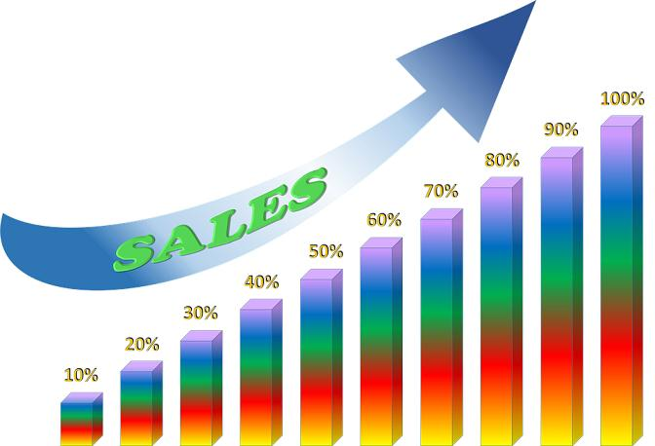
Sales data prediction in supermarket.

Slide 2
Why need to predict the sales data analysis in marketing.
Improve marketing strategies, identify seasonal trends, make informed business decisions, manage the supply chain, enhance customer satisfaction, and gain a competitive advantage.

Slide 3

Problem Statement:-
Seasonality
Out-of-Stock Situations
Data Quality
Market Competition
Consumer Preferences

Slide 4
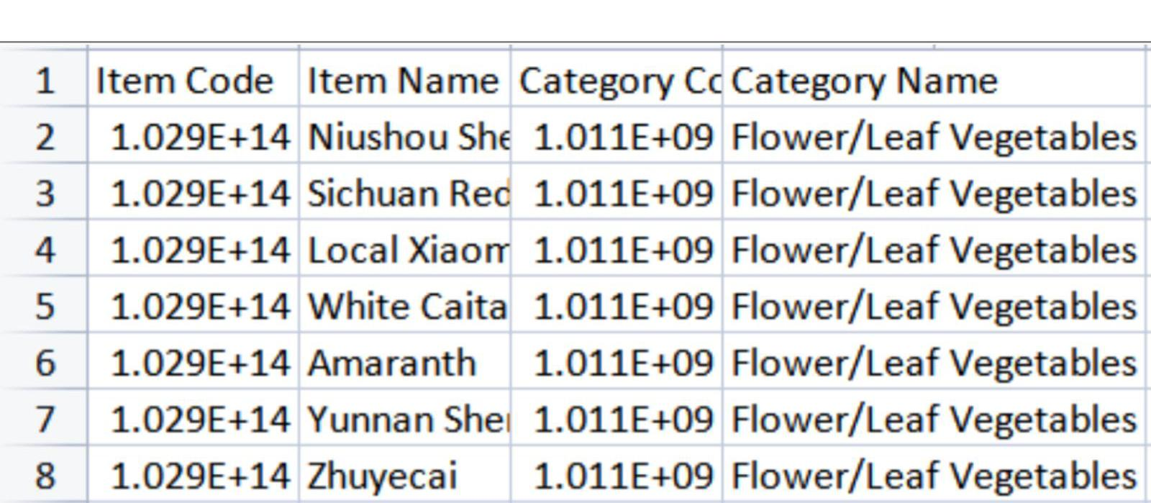
DATASET ANALYSIS:-

Slide 5
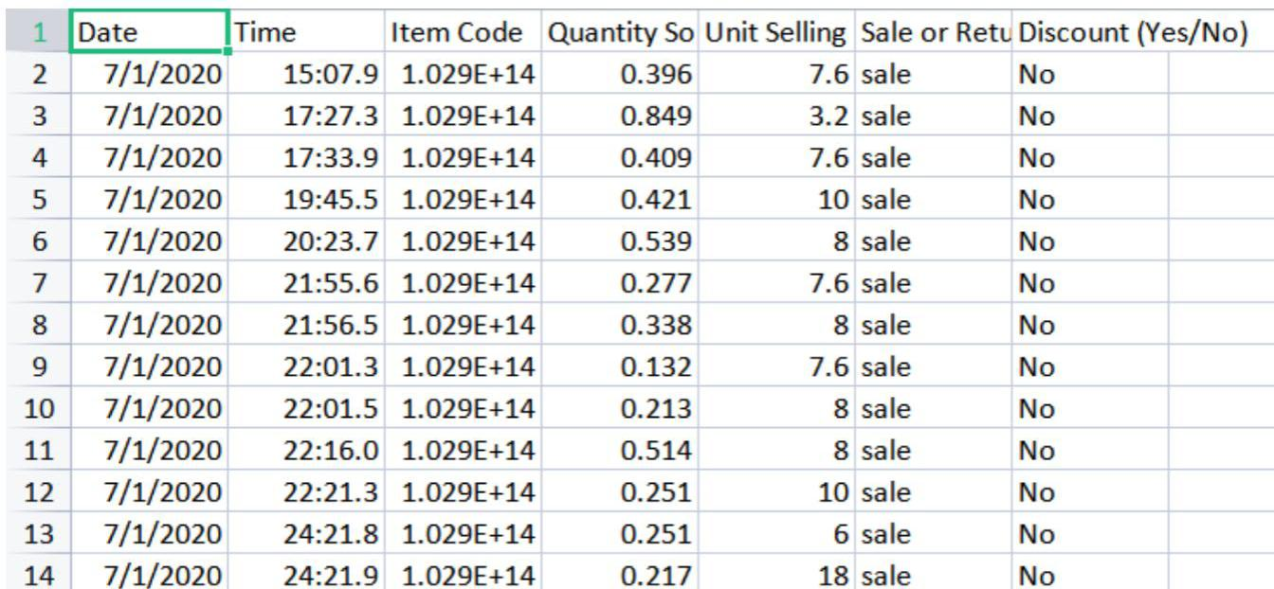

Slide 6
ENVIRONMENTAL SETUP
To solve these problems ,we need to set :
High security
Install cctv
Set security sensors
Check labels with staffs

Slide 7
SETUPS:-
We can use magnetic tag to reduce the theft in the store.
Reduce the unsold stock ,in the unwanted period.
Globalize the market and make popular of the market, which increase the customer rate.
Refridgerate the vegetables and foods.

Slide 8

Data flow daigram for super market :-

Slide 9
Code:-
import pandas as pd
import matplotlib.pylab as plt
df=pd.read_csv(r"C:/Users/ajaya/Downloads/archive (1)/annex2.csv")
df=df.head(30) df1=pd.read_csv(r"C:/Users/ajaya/Downloads/archive (1)/annex4.csv")
df1=df1.head(20)
df.head(10)

Slide 10
Result Analysis:-
the problems for the supermarket has been solved using the data analysis.
These process is done from the given previous .
We have trained the dataset and have got the accuracy rate for the given dataset .
With the given data we have found the solution for the problems in the supermarkets.
This is done using the data analysis process.
Thus , we conclude the data analysis can give solution predict the need of it.

Slide 11
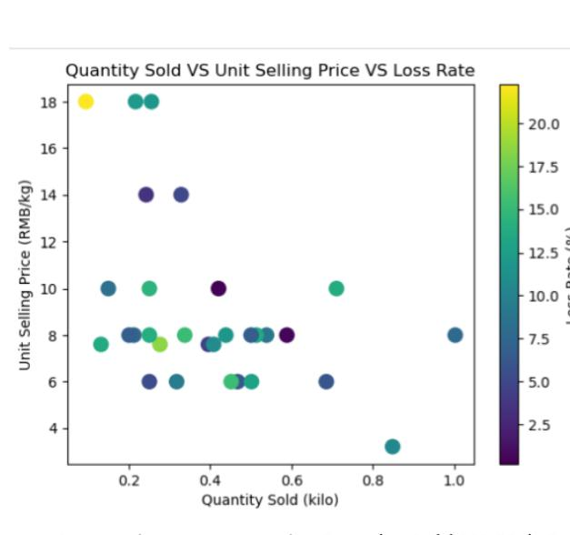
Result:-

